Slide 1
PLT: Week 10
Bottom-up, LR parsing
Finishing off LR(0) parsing
Automating the creation of the FSA
Looking to LR(1) parsing
Notes:
<νυμβερ>

Slide 2
The core of Bottom Up parsing
Core of Top-Down:
  Moving from LHS to (correct) RHS of production rules
Core of Bottom Up;
  Moving from RHS to LHS of production rules
        T-> g r
        T-> g r w
  Achieved by:
    Knowing when to shift another symbol from input on to the stack;
    Knowing when to reduce from the RHS to the LHS of production rule;
    Knowing what contextual state we are in;
    Knowing what contextual state we need to go to when new terminals/non-terminals are considered.
Notes:
<νυμβερ>
Core of bottom up: Deciding when what-looks-like a RHS of a production rule can be transformed into a LHS
tratrr

Slide 3
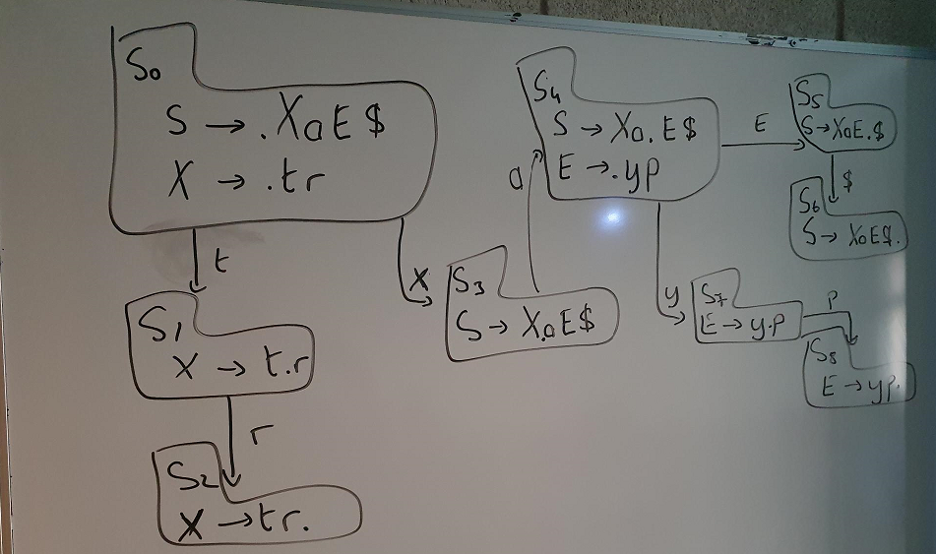
Finishing off tutorial
– S -> X a E $
– X -> t r
– E -> y p
Action table, Goto table, parse trayp$

Slide 4
Optional
Show C code that:
  Generates the FSA or more correctly the CFSM;
    Based on closure function
    Based on go-to function
Show C code that:
  Generates a go-to table from the CFSM
Notes:
<νυμβερ>

Slide 5
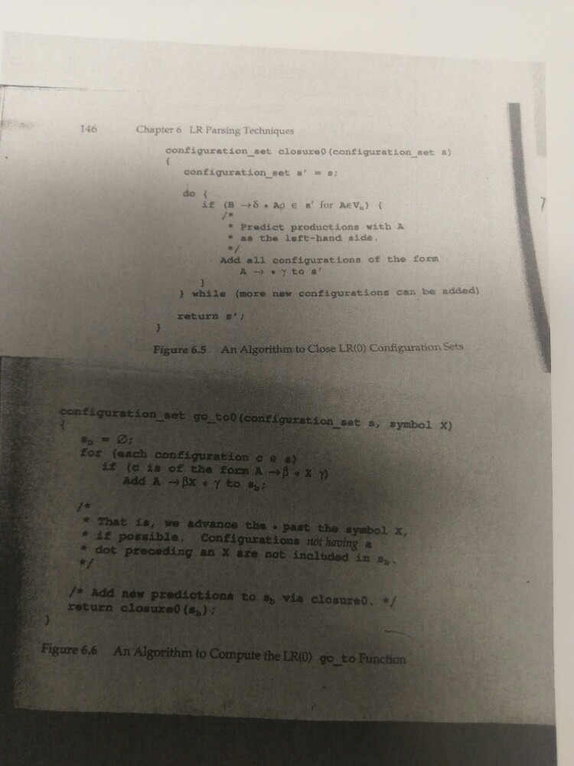
Add configs for when dot is before V_{N}
Add initial configs to state based on FSM edges
Are more configs needed based on dot being to LHS of V_{N}

Slide 6
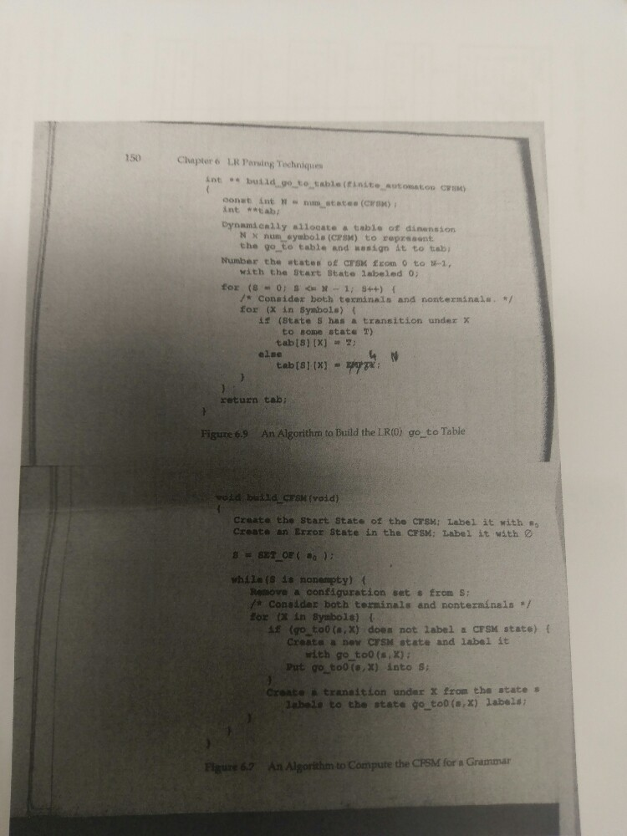
Empty state
an existing

Slide 7
LR(1)
S->E$
E->E+T
E->T
T->T*P
T->P
P->id //here id reps 1 terminal
P->(E)
What happens if we get a T transition in state S₀?

Slide 8
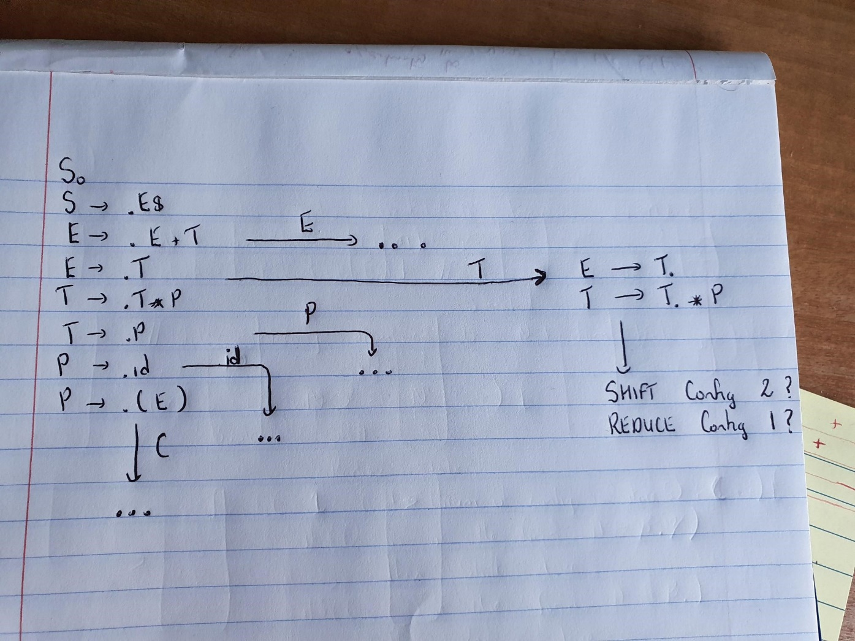
LR(1)
S->E$
E->E+T | T
T->T*P|P
P->id|(E) //id represents 1 terminal to align with the book

Slide 9
LR(1)
E-> T.
T->T.*P
What happens if we get a T transition in state S₀?
  Do we shift or reduce?
  We need extra knowledge, not just past context (on stack) but we also need to know what’s coming next;
  The FSA must contain LA information – what must come next in the language instance, if we choose to reduce;

Slide 10
The Solution: LR(1)
Look ahead 1 token on the input stream;
For each configuration in the state, figure out what token could come after it when it is fully matched (again called the look-ahead component):
If you are in a state where you have a shift-reduce conflict:
  Look at the next input token;
  For the production that you might reduce, see if that token is in its look-ahead set.
  If so, reduce, if not shift.
Notes:
<νυμβερ>

Slide 11
Calculating look-ahead
S->.E$ {lambda }
E->.E+T { }
E->.T { }
T->.T*P { }
T->.P { }
P->.id { }
P->.(E) { }
And specifically state 7 (state 0 under transition T)

Slide 12
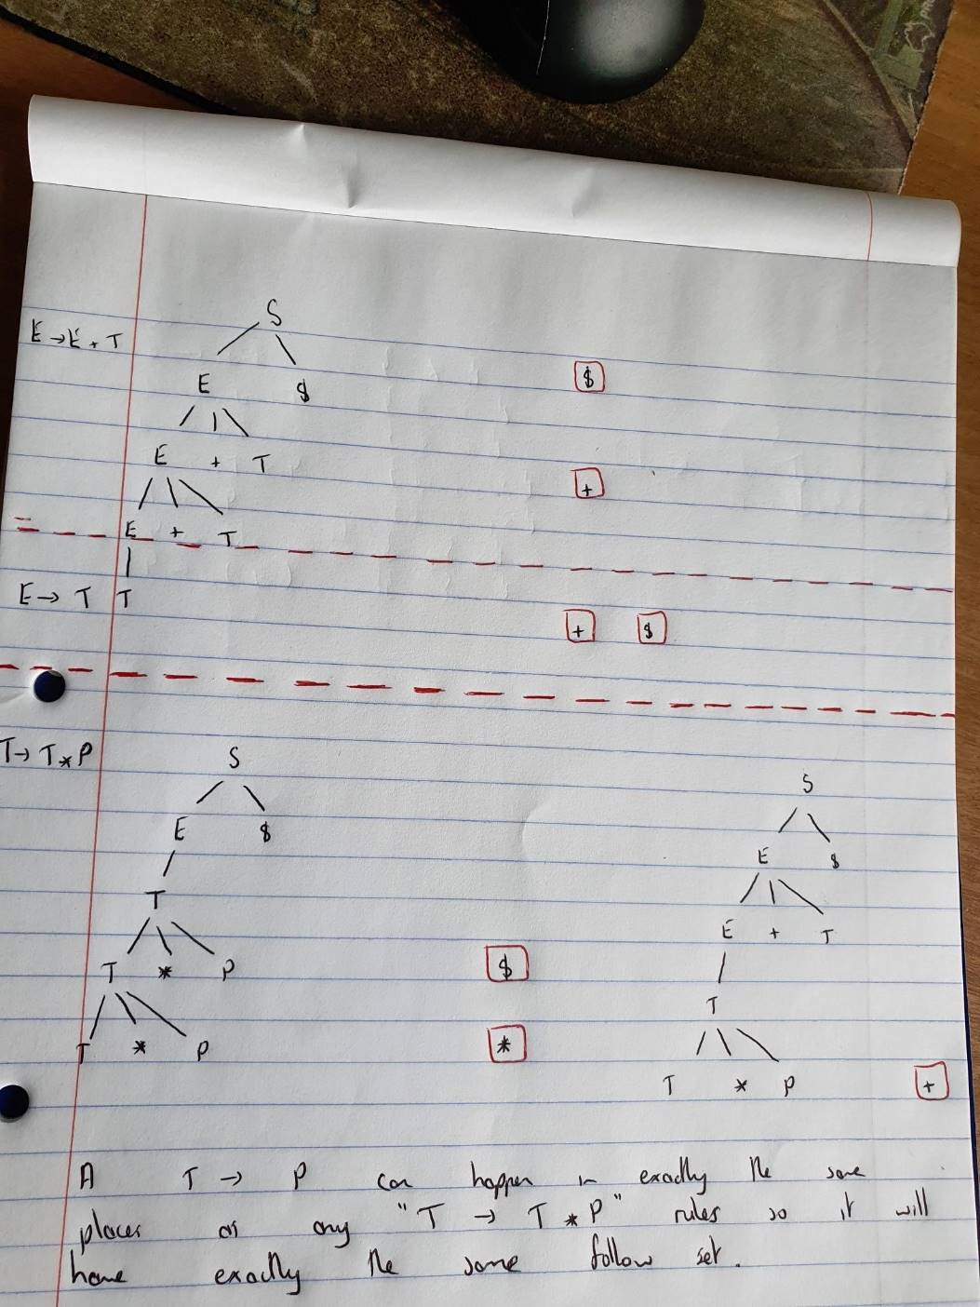

Slide 13
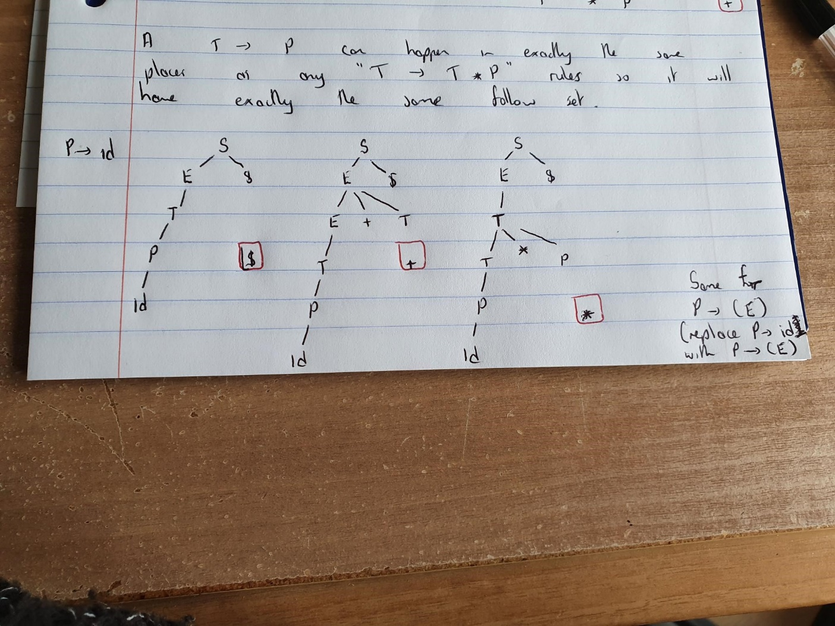
Last 2 Productions

Slide 14
Calculating look-ahead
S->.E$ {lambda }
E->.E+T {$, + }
E->.T {$, + }
T->.T*P {$,*, + }
T->.P {$, *, + }
P->.id {$, +, * }
P->.(E) {$, +, * }
And specifically state 7 (state 0 under transition T)

Slide 15
The solution for our Grammar: State 0 and T transition
State 7:
  E -> T. {$ +}
  T -> T. * P {$ + *}
So if the next thing coming at us in our language instance is $ or + we will reduce T to E
Otherwise we will continue shifting on to an *
Or getting a parsing error…

Slide 16
Another LR(1) Grammar
S -> HP$
H -> d
H -> drg
P -> tP
P -> mn
FSM, Goto table, Action table
Walkthrough: dttmn

Slide 17
Another LR(1) Grammar
S -> G r P $
G -> Q
G -> Q a d
Q -> h
P -> g
Create the FSA, goto table, and action table. Show how you would use these tables to parse hadrg$
Notes:
Show we need LR(1) – then get them to do it...
<νυμβερ>

Slide 18
Bottom Up parsing
So far we have looked at the Shift-(or)-Reduce problem:
      R -> T r s
      R -> T r s g
What about the Which-Way to Reduce problem:
      S -> Y a P r $
      Y -> D n
      D -> a
      D -> q
      P -> w e
      P -> q
Notes:
<νυμβερ>
Core of bottom up: Deciding when what-looks-like a RHS of a production rule can be transformed into a LHS
tratrr

